Slide 1
Malpositions and Malpresentations
Sanjeewa Padumadasa

Slide 2
Presentation of the fetus
Leading part of the fetus in relation to the pelvic brim
Normal presentation in cephalic presentation is vertex presentation
Vertex is the area of the fetal head surrounded by the two fontanellae and the two parietal eminences

Slide 3
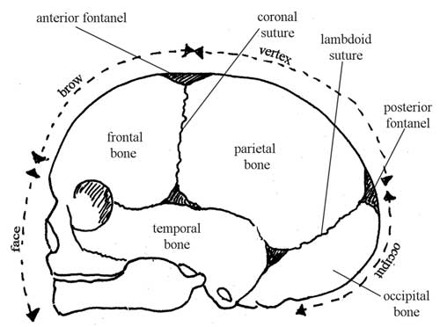
The bones of the fetal skull showing their relationships to fetal presentations

Slide 4
Position of the fetal presenting part
Position of the fetal presenting part is the relationship of the presenting part of the fetus to the maternal pelvis
The denominator or the reference point of the presenting part is the
Occiput in cephalic presentation
Sacrum of the fetus in breech presentation
Normal position is occipito anterior position
Commonly LOA

Slide 5
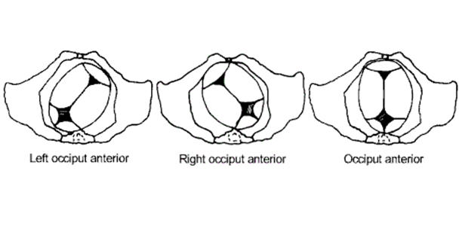
Occipito-anterior position

Slide 6
Malpositions
A position other than normal position is called malposition
Occipito posterior position in cephalic presentation
Sacro posterior position in breech presentation
Can lead to prolonged labour

Slide 7
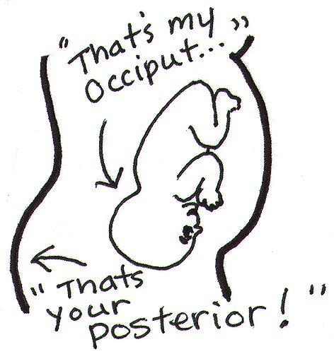
Occipito-posterior position

Slide 8
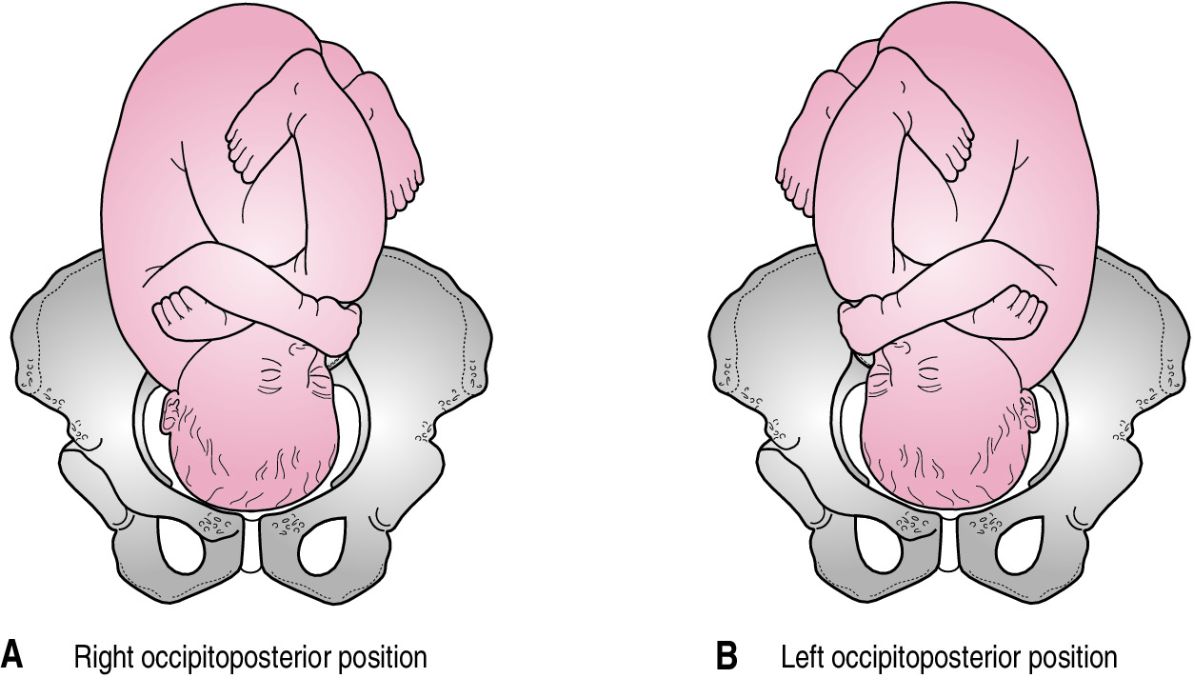

Slide 9
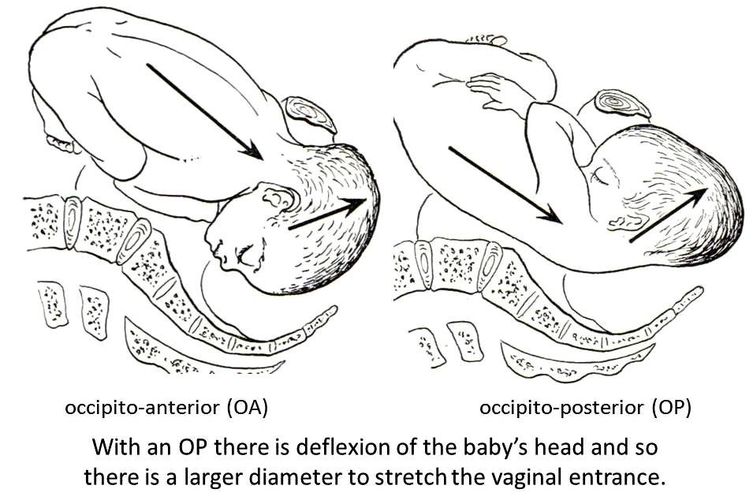
Occipito-posterior position

Slide 10
Occipito posterior position
Common in primigravidae
Associated with anthropoid and android pelvis
Associated with anterior wall placenta
Maternal anterior abdominal wall muscle tone
Increased tone is in favour of this position – Primi

Slide 11
Occipito posterior position – Abdominal findings
Head is not engaged
Head is deflexed
Occiput and the sinciput are at the same level
Fetal back is laterally or posteriorly placed
Fetal limbs are easily palpable
Flattening of the abdomen
Fetal heart sounds are faint

Slide 12
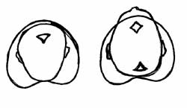
Occipito posterior position – Vaginal examination findings
Anterior fontanelle is placed anteriorly and easy to palpate
Posterior fontanelle is placed posteriorly
Can palpate both fontanellae due to deflexion of the head

Slide 13
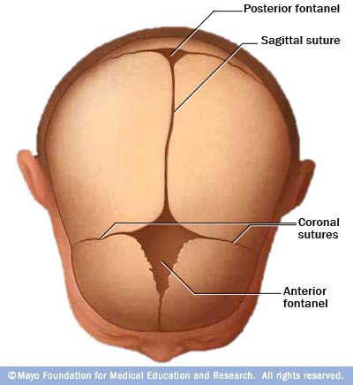
The anterior fontanelle will easily be palpable on vaginal examination in the case of a deflexed head.

Slide 14
Occipito posterior position - In labour
About 2/3rd will rotate into occipito anterior position
Few will become direct OPP and deliver as face to pubes
Deep transverse arrest
Secondary Brow or Secondary Face presentation

Slide 15
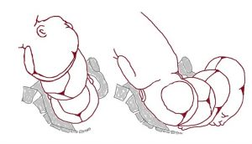
The majority of occipito posterior positions will rotate to occipito anterior in labour.

Slide 16
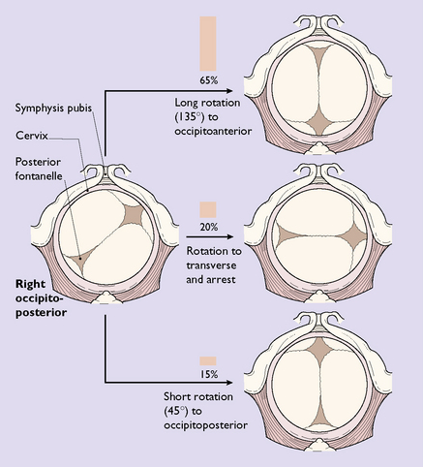

Slide 17
Direct occipito posterior position – Management
Can be delivered as face to pubes
Traction Forceps or ventouse when there is delay
Rotational forceps - Kjelland’s forceps
Caesarean section if there is CPD or problems in the first stage

Slide 18
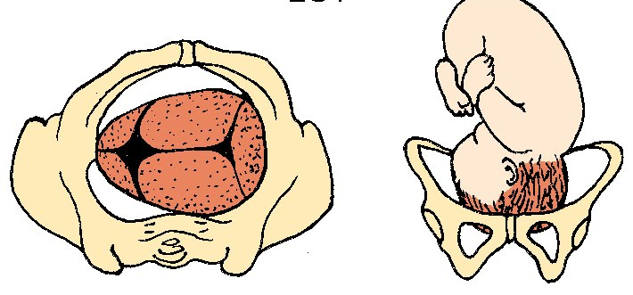
Deep transverse arrest

Slide 19
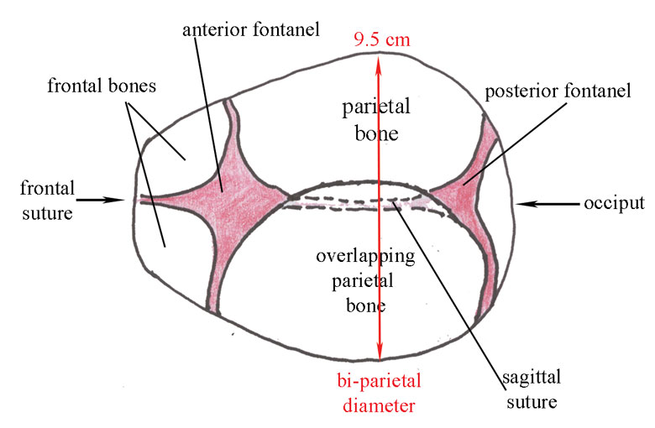

Slide 20
Deep transverse arrest – Management
The head is arrested in occipito lateral position
Manual rotation + / - traction forceps
Ventouse
Rotational forceps
Caesarean section

Slide 21
Malpresentations
Presentation which is other than cephalic is called malpresentation
Primary face and brow presentation
Shoulder presentation
Dorsal presentation
“Cord presentation”
Breech presentation

Slide 22
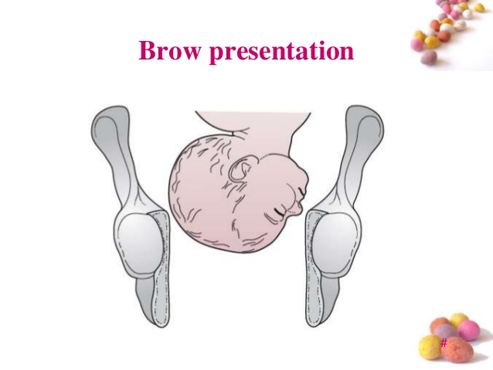
Brow presentation

Slide 23
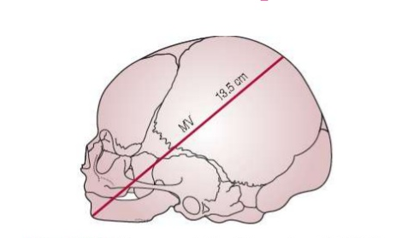
The presenting diameter in a brow presentation

Slide 24
Brow presentation
Due to extension of the fetal head
Effective diameter of the fetal head is mento vertical diameter
This is the largest diameter of the fetal head and in a term fetus measures 13.5 cm
Caesarean section is required

Slide 25
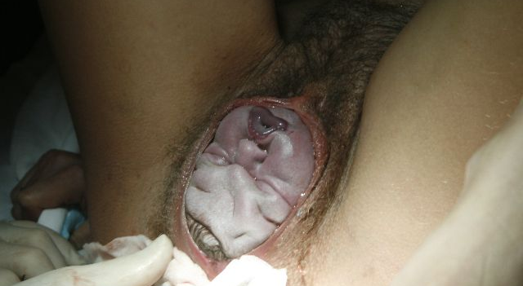
Face presentation
Due to extension of the fetal head
Effective diameter is sub mento bregmatic diameter which is 9.5 cm
Usually mento anterior position
Can be delivered vaginally
Ventouse cannot be applied

Slide 26
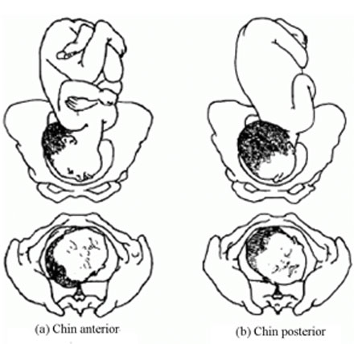

Slide 27
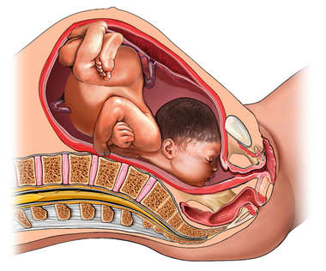
Face presentation – mento posterior position.

Slide 28
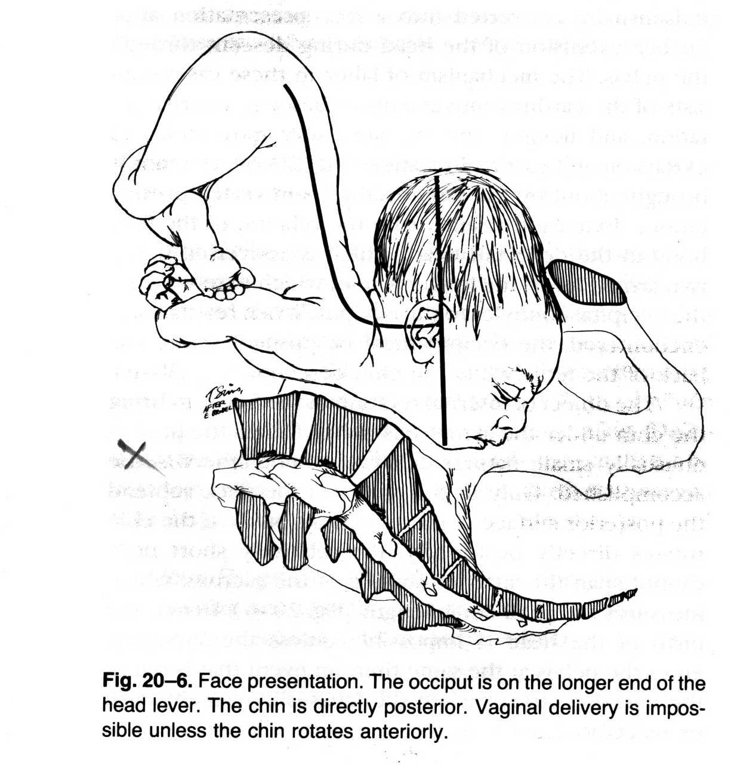
Mento-posterior face presentation

Slide 29
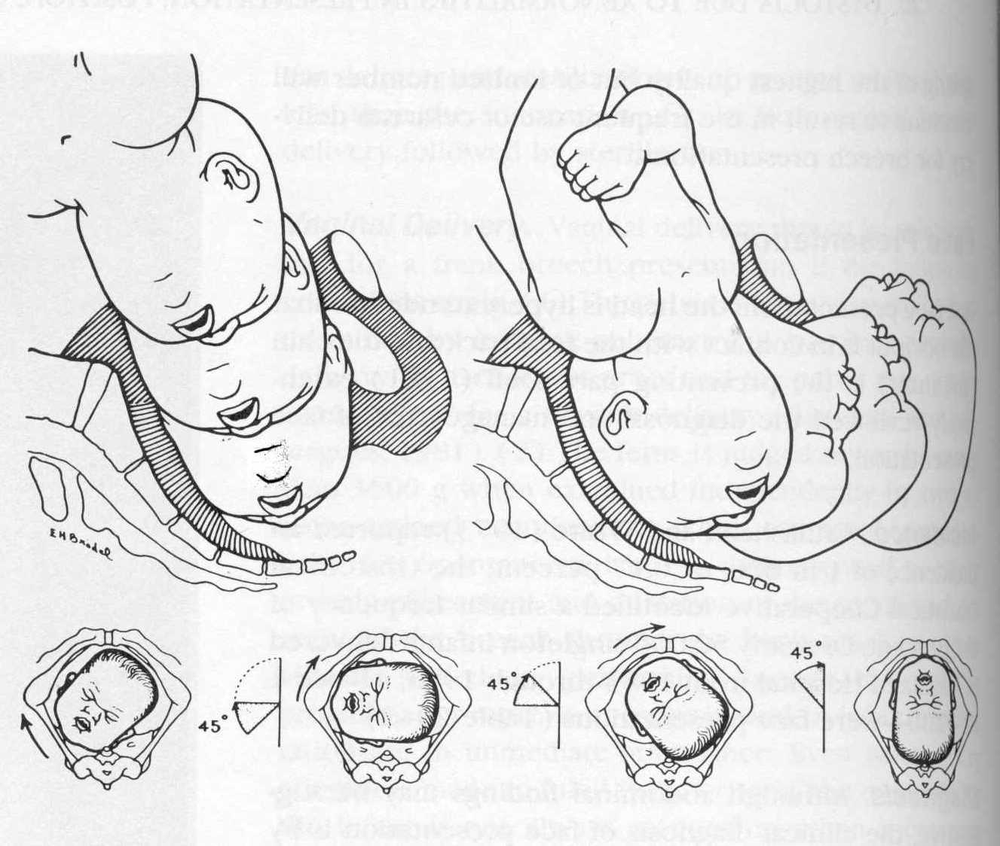

Slide 30
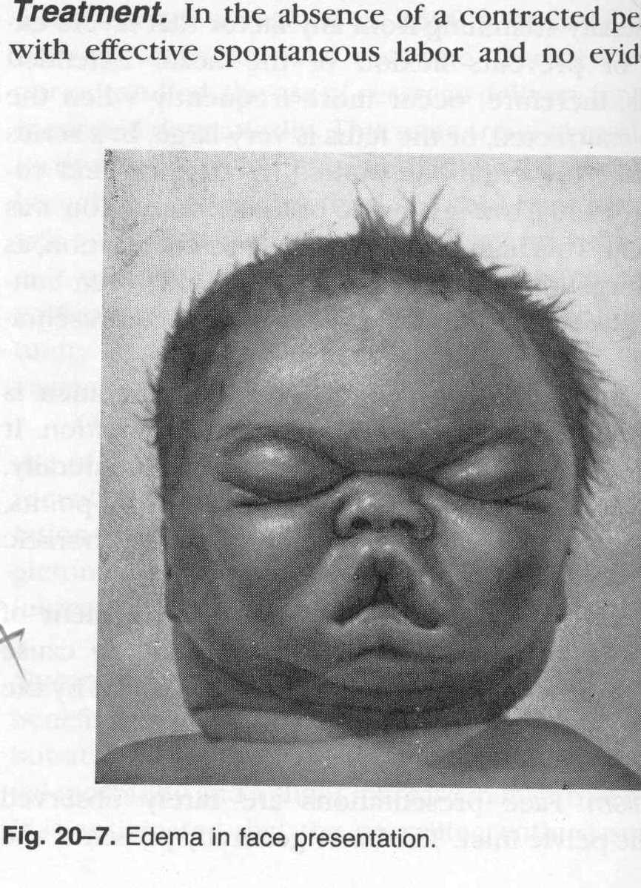
Oedema in face presentation – Usually resolves within 24 hrs

Slide 31
Causes for face and brow presentations
Primary brow and face share the same aetiological factors
Permanent extension of the fetal neck
due to
cervical spine deformities
goitre
hygroma
brachial cysts etc.

Slide 32
Sacro posterior position in breech presentation
This must be avoided during vaginal breech delivery
Delivery of the after coming head is difficult as it will be in an occipito-posterior position

Slide 33
Shoulder and dorsal presentations
Seen with transverse and oblique lie
Can lead to hand prolapse and cord prolapse
External cephalic version if there are no contra indications such as placenta praevia
Elective caesarean section

Slide 34
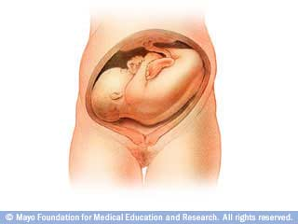
Shoulder presentation

Slide 35
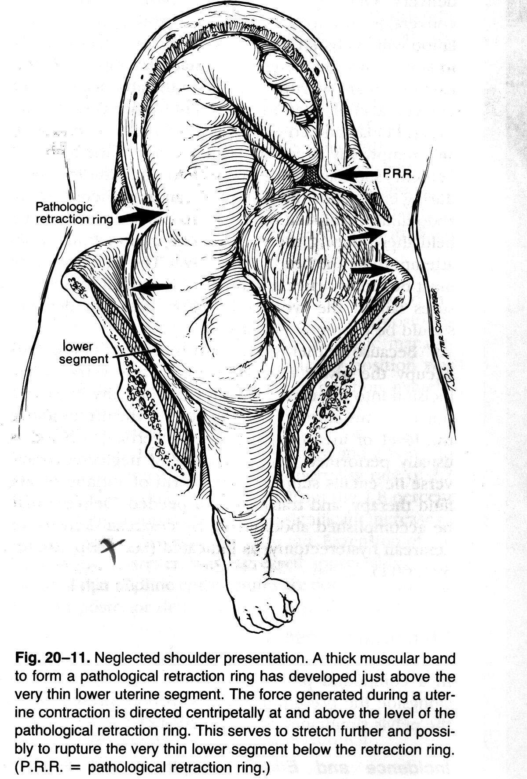
Neglected shoulder presentation
A thick muscular band to form a pathological retraction ring has developed just above the very thin lower uterine segment
The force generated during a uterine contraction is directed centripetally at and above the level of the pathological retraction ring
This serves to stretch further and possibly to rupture the very thin lower segment below the retraction ring
(P.R.R. = pathological retraction ring)

Slide 36
Cord presentation
Presence of the umbilical cord in front of the presenting part with intact membranes
Should be excluded before amniotomy by feeling for the cord pulsation
Can lead to cord prolapse
Emergency caesarean section should be carried out if immediate vaginal delivery is not possible
Prolapse in 1st stage – Caesarean section
Prolapse in 2nd stage – Instrumental delivery

Slide 37
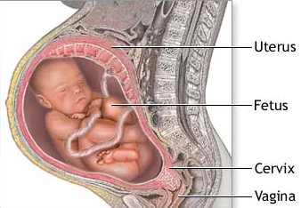

Slide 38
Breech presentation
Commonest malpresentation
When the fetal buttocks occupy the lower part of the uterus
2-3 % after 37 weeks
Much higher incidence among preterm babies

Slide 39
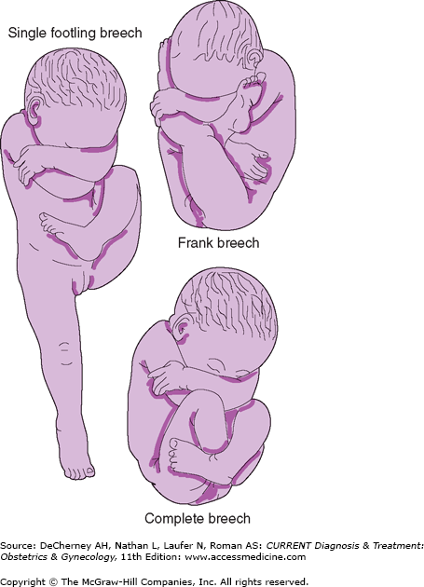
Main types of breech presentation

Slide 40
Types of breech
Extended breech - Frank breech in primigravidae
50–70%
Hips flexed, knees extended
Flexed breech - Complete or full breech
5–10%
Hips flexed, knees flexed
Footling/Incomplete breech
10-30%
One or both hips extended
Foot presenting

Slide 41
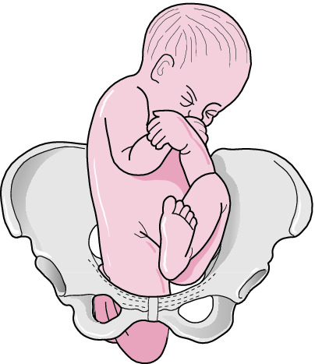
Knee presentation – a rare type of breech

Slide 42
Breech presentation
Increased perinatal mortality and morbidity
Vaginal breech delivery
Abnormalities
Prematurity

Slide 43
Breech – Predisposing factors
Placental - Placenta praevia
Uterine - Bicornuate uterus, Fibroids
Fetal – Hydrocephalus, other abnormalities
Amniotic fluid - Polyhydramnios
Maternal - Inadequate maternal pelvis
Fetal death, preterm
Idiopathic
Multiple pregnancy

Slide 44
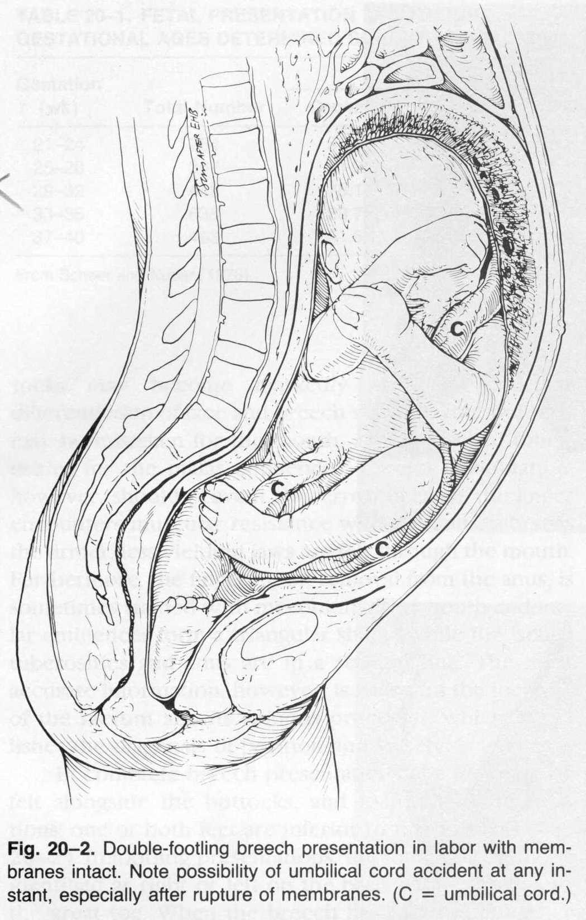
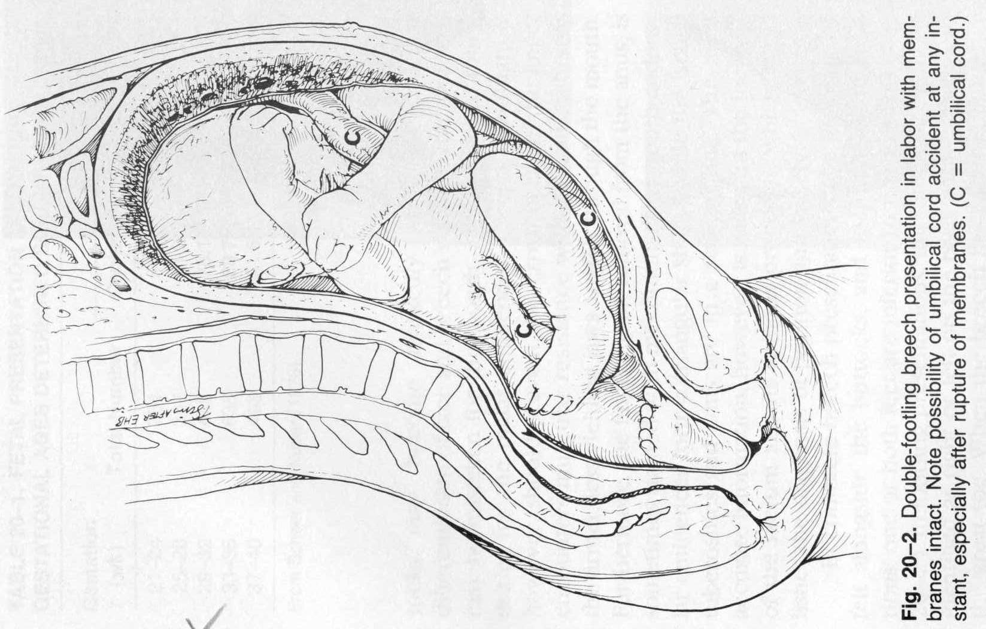

Slide 45
Management of breech
External cephalic version
This should be offered at 36-37 weeks under ultrasound guidance
Baby is gently manipulated into cephalic presentation
Exclude factors that preclude vaginal delivery
Other obstetric complications
Exclude fetal anomalies
Assisted vaginal breech delivery or elective caesarean section

Slide 46
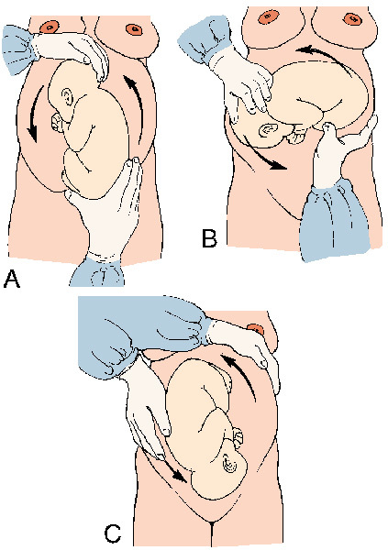
External cephalic version

Slide 47
Contraindications to ECV
Pre eclampsia
Previous scar on the uterus
Multiple pregnancy
Fetal abnormality
Placenta praevia
Oligo/polyhydramnios
History of ante partum haemorrhage

Slide 48
Assisted vaginal breech delivery
Type of breech
Maintain a partogram
Experienced staff member to assess patient
Adequate analgesia
Do not hesitate to revise decision
Inform paediatrician
Be prepared for emergency caesarean section

Slide 49
Indications for caesarean section in breech presentation
Feto-pelvic disproportion
Elderly primi
Subfertile primi
Past section
Footling breech
Placenta praevia
Intra uterine growth restriction
Twin pregnancy

Slide 50
Complications of breech presentation
Preterm rupture of membranes
Cord prolapse
Intra cranial haemorrhage
Erb’s paralysis
Rupture of a viscus (Liver, Kidney)
Dislocation of shoulder
Clavicular fracture
Dislocation of hip joint

Slide 51
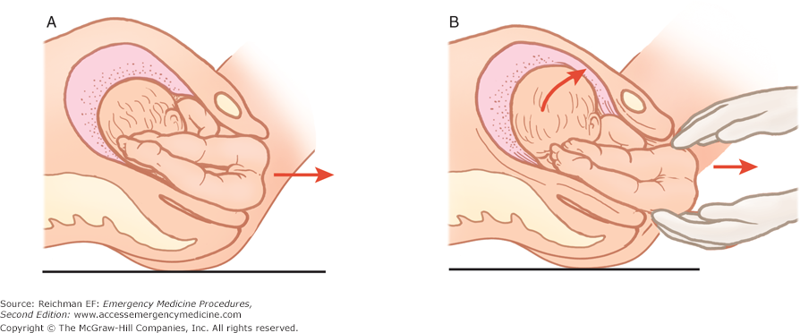
Avoid traction when performing an assisted vaginal breech delivery. Rotatory movements are allowed.

Slide 52
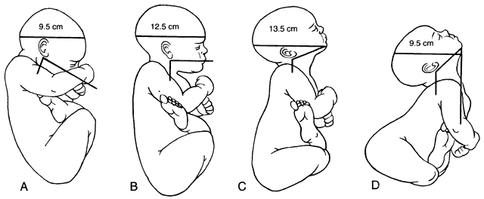
Importance of cranial flexion is emphasized by noting the increased diameters presented to the birth canal with progressive defexion. A. Flexed head.

Slide 53
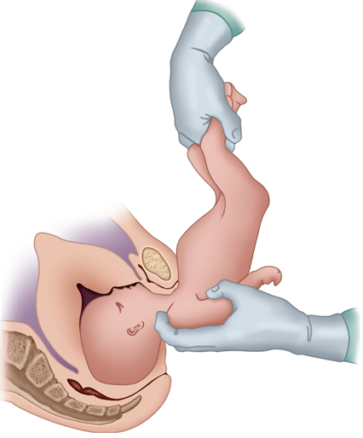
Avoid sacro posterior position as this will increase the presenting diameter of the fetal head

Slide 54
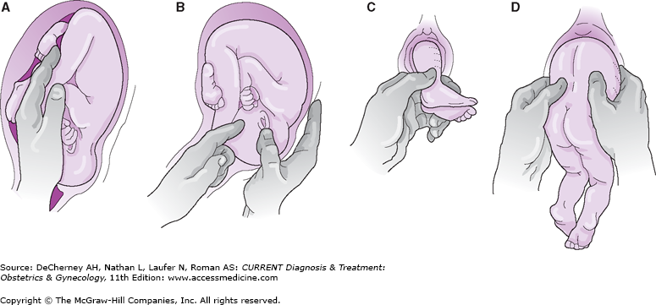
Internal podalic version and breech extraction

